Slide 1

COMP-SCI 5590 - 0001 Special Topics
Introduction To Python
A readable, dynamic, pleasant, flexible, fast and powerful language

Slide 2
Tutorial 4
Classes
Object Oriented Concepts
Instances
Init
self
Private, Protected, Public
Inheritance
Scientific Python
Numpy Package

Slide 3
Defining a Class
A class is wrapping up of data and functions into one unit.
It is a software item which contains variables and methods.
The class also stores some data items that are shared by all the instances of this class
Objects are Instances of a class
Python doesn’t use separate class interface definitions as in some languages

Slide 4
Methods in Classes
Define a method in a class by including function definitions within the scope of the class block
There must be a special first argument self in all of method definitions which refers to the calling instance
There is usually a special method called __init__ in most classes. It is called the default constructor.

Slide 5
A simple class def: student
__init__ is the default constructor
class student: “““A class representing a student ””” def __init__(self,n,a): self.full_name = n self.age = a def get_age(self): return self.age
self refers to the object itself,
like this in Java.

Slide 6
Object Oriented Concepts
Object Oriented Design focuses on
Encapsulation:
dividing the code into a public interface, and a private implementation of that interface
Polymorphism:
the ability to overload standard operators so that they have appropriate behavior based on their context
Inheritance:
the ability to create subclasses that contain specializations of their parents

Slide 7
It’s all objects…
Everything in Python is really an object.
We’ve seen hints of this already… “hello”.upper() list3.append(‘a’) dict2.keys()
These look like Java or C++ method calls.
New object classes can easily be defined in addition to these built-in data-types.
In fact, programming in Python is typically done in an object oriented fashion.

Slide 8
Creating and Deleting Instances

Slide 9
Instantiating Objects
Just use the class name with ( ) notation and assign the result to a variable
__init__ serves as a constructor for the class. Usually does some initialization work
The arguments passed to the class name are given to its __init__() method
So, the __init__ method for student is passed “Bob” and 21 and the new class instance is bound to b:
b = student(“Bob”, 21)

Slide 10
Constructor: __init__
An __init__ method can take any number of arguments.
Like other functions or methods, the arguments can be defined with default values, making them optional to the caller.
However, the first argument self in the definition of __init__ is special…

Slide 11
Self
The first argument of every method is a reference to the current instance of the class
By convention, we name this argument self
In __init__, self refers to the object currently being created; so, in other class methods, it refers to the instance whose method was called
Similar to the keyword this in Java or C++
But Python uses self more often than Java uses this

Slide 12
Self
Although you must specify self explicitly when defining the method, you don’t include it when calling the method.
Python passes it for you automatically
Defining a method: Calling a method:
(this code inside a class definition.)
def set_age(self, num): >>> x.set_age(23) self.age = num

Slide 13
Deleting instances: No Need to “free”
When you are done with an object, you don’t have to delete or free it explicitly.
Python has automatic garbage collection.
Python will automatically detect when all of the references to a piece of memory have gone out of scope. Automatically frees that memory.
Generally works well, few memory leaks
There’s also no “destructor” method for classes

Slide 14
Definition of student
class student: “““A class representing a student ””” def __init__(self,n,a): self.full_name = n self.age = a def get_age(self): return self.age

Slide 15
Traditional Syntax for Access
>>> f = student(“Bob Smith”, 23)
>>> f.full_name # Access attribute
“Bob Smith”
>>> f.get_age() # Access a method
23

Slide 16
Accessing unknown members
Problem: Occasionally the name of an attribute or method of a class is only given at run time…
Solution:
getattr(object_instance, string)
string is a string which contains the name of an attribute or method of a class
getattr(object_instance, string) returns a reference to that attribute or method

Slide 17
getattr(object_instance, string)
>>> f = student(“Bob Smith”, 23)
>>> getattr(f, “full_name”)
“Bob Smith”
>>> getattr(f, “get_age”)
<method get_age of class studentClass at 010B3C2>
>>> getattr(f, “get_age”)() # call it
23
>>> getattr(f, “get_birthday”)
# Raises AttributeError – No method!

Slide 18
hasattr(object_instance,string)
>>> f = student(“Bob Smith”, 23)
>>> hasattr(f, “full_name”)
True
>>> hasattr(f, “get_age”)
True
>>> hasattr(f, “get_birthday”)
False

Slide 19
Two Kinds of Attributes
The non-method data stored by objects are called attributes
Data attributes
Variable owned by a particular instance of a class
Each instance has its own value for it
These are the most common kind of attribute
Class attributes
Owned by the class as a whole
All class instances share the same value for it
Called “static” variables in some languages
Good for (1) class-wide constants and (2) building counter of how many instances of the class have been made

Slide 20
Data Attributes
Data attributes are created and initialized by an __init__() method.
Simply assigning to a name creates the attribute
Inside the class, refer to data attributes using self
for example, self.full_name
class teacher: “A class representing teachers.” def __init__(self,n): self.full_name = n def print_name(self): print self.full_name

Slide 21
Class Attributes
Because all instances of a class share one copy of a class attribute, when any instance changes it, the value is changed for all instances
Class attributes are defined within a class definition and outside of any method
Since there is one of these attributes per class and not one per instance, they’re accessed via a different notation:
Access class attributes using self.__class__.name notation -- This is just one way to do this & the safest in general.
class sample: >>> a = sample() x = 23 >>> a.increment() def increment(self): >>> a.__class__.x self.__class__.x += 1 24

Slide 22
Data vs. Class Attributes
class counter: overall_total = 0 # class attribute def __init__(self): self.my_total = 0 # data attribute def increment(self): counter.overall_total = \ counter.overall_total + 1 self.my_total = \ self.my_total + 1
>>> a = counter() >>> b = counter() >>> a.increment() >>> b.increment() >>> b.increment() >>> a.my_total 1 >>> a.__class__.overall_total 3 >>> b.my_total 2 >>> b.__class__.overall_total 3

Slide 23
Inheritance

Slide 24
Inheritance
Basic syntax for a derived class definition:
class DerivedClassName(BaseClassName):
<statement-1>
. . .
<statement-N>
As stated before, all methods are virtual by default
If a method in DerivedClassName above has the same name and parameters as BaseClassName, the method in the derived class will be implemented when its called

Slide 25
Subclasses
A class can extend the definition of another class
Allows use (or extension ) of methods and attributes already defined in the previous one.
New class: subclass. Original: parent, ancestor or superclass
To define a subclass, put the name of the superclass in parentheses after the subclass’s name on the first line of the definition. Class Cs_student(student):
Python has no ‘extends’ keyword like Java.
Multiple inheritance is supported.

Slide 26
Multiple Inheritance
class DerivedClassName(Base1, Base2, Base3):
<statement-1>
. . .
<statement-N>
Program searches through each base class left to right when searching for attributes
If Base1 is a derived class, the program will go through its base classes recursively to complete the search

Slide 27
Redefining Methods
To redefine a method of the parent class, include a new definition using the same name in the subclass.
The old code won’t get executed.
To execute the method in the parent class in addition to new code for some method, explicitly call the parent’s version of the method.
parentClass.methodName(self, a, b, c)
The only time you ever explicitly pass ‘self’ as an argument is when calling a method of an ancestor.

Slide 28
Definition of a class extending student
Class Student: “A class representing a student.”
def __init__(self,n,a): self.full_name = n self.age = a
def get_age(self): return self.age
Class Cs_student (student): “A class extending student.” def __init__(self,n,a,s): student.__init__(self,n,a) #Call __init__ for student
self.section_num = s def get_age(): #Redefines get_age method entirely print “Age: ” + str(self.age)
Passing another class as parent

Slide 29
Extending __init__
Same as for redefining any other method…
Commonly, the ancestor’s __init__ method is executed in addition to new commands.
You’ll often see something like this in the __init__ method of subclasses:
parentClass.__init__(self, x, y) where parentClass is the name of the parent’s class.

Slide 30
Special Built-In Methods and Attributes

Slide 31
Built-In Members of Classes
Classes contain many methods and attributes that are included by Python even if you don’t define them explicitly.
Most of these methods define automatic functionality triggered by special operators or usage of that class.
The built-in attributes define information that must be stored for all classes.
All built-in members have double underscores around their names: __init__ __doc__

Slide 32
Special Methods
For example, the method __repr__ exists for all classes, and you can always redefine it
The definition of this method specifies how to turn an instance of the class into a string
print f sometimes calls f.__repr__() to produce a string for object f
If you type f at the prompt and hit ENTER, then you are also calling __repr__ to determine what to display to the user as output

Slide 33
Special Methods – Example
class student: ... def __repr__(self): return “I’m named ” + self.full_name ...
>>> f = student(“Bob Smith”, 23)
>>> print f
I’m named Bob Smith
>>> f
“I’m named Bob Smith”

Slide 34
Special Methods
You can redefine these as well:
__init__ : The constructor for the class
__cmp__ : Define how == works for class
__len__ : Define how len( obj ) works
__copy__ : Define how to copy a class
Other built-in methods allow you to give a class the ability to use [ ] notation like an array or ( ) notation like a function call

Slide 35
Special Data Items
These attributes exist for all classes.
__doc__ : Variable for documentation string for class
__class__ : Variable which gives you a reference to the class from any instance of it
__module__ : Variable which gives a reference to the module in which the particular class is defined
__dict__ :The dictionary that is actually the namespace for a class (but not its superclasses)
Useful:
dir(x) returns a list of all methods and attributes defined for object x

Slide 36
Special Data Items – Example
>>> f = student(“Bob Smith”, 23)
>>> print f.__doc__
A class representing a student.
>>> f.__class__
< class studentClass at 010B4C6 >
>>> g = f.__class__(“Tom Jones”, 34)

Slide 37
Private Variables
Programmers that use python typically use an underscore as a prefix to private variables
Ex: __color
Name mangling – a method used by programmers to avoid name clashes by subclasses and their base classes
Syntax: _classname__color

Slide 38
Private Data and Methods
Any attribute/method with 2 leading under-scores in its name (but none at the end) is private and can’t be accessed outside of class
Note: Names with two underscores at the beginning and the end are for built-in methods or attributes for the class
Note: There is no ‘protected’ status in Python; so, subclasses would be unable to access these private data either.

Slide 39
Private,Protected and Public
Name | Notation | Behaviour
name | Public | Can be accessed from inside and outside
_name | Protected | Like a public member, but they shouldn't be directly accessed from outside.
__name | Private | Can't be seen and accessed from outside

Slide 40
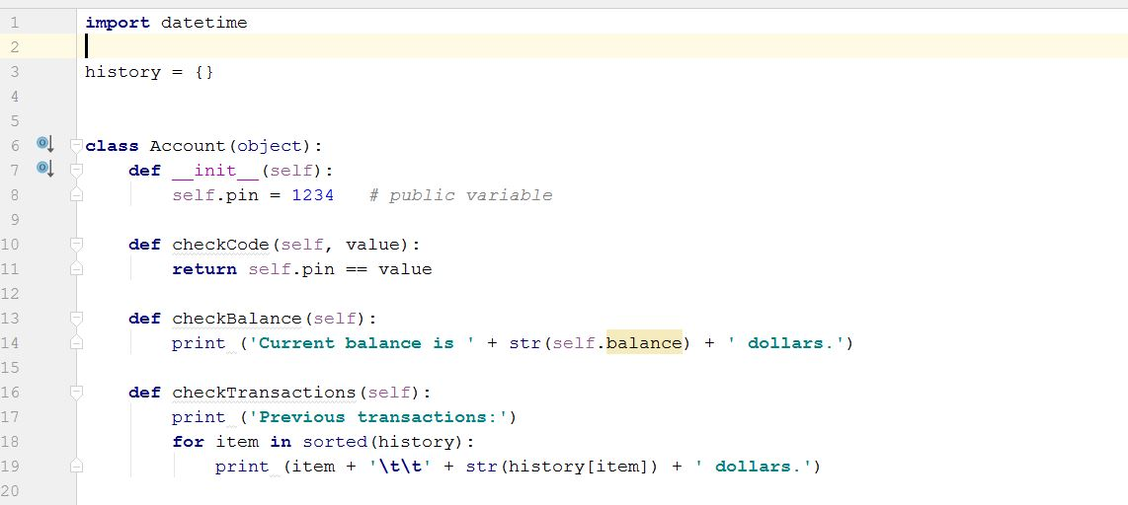
Use case 1- Bank Account
Class Declaration
Default Constructor
Member Functions

Slide 41
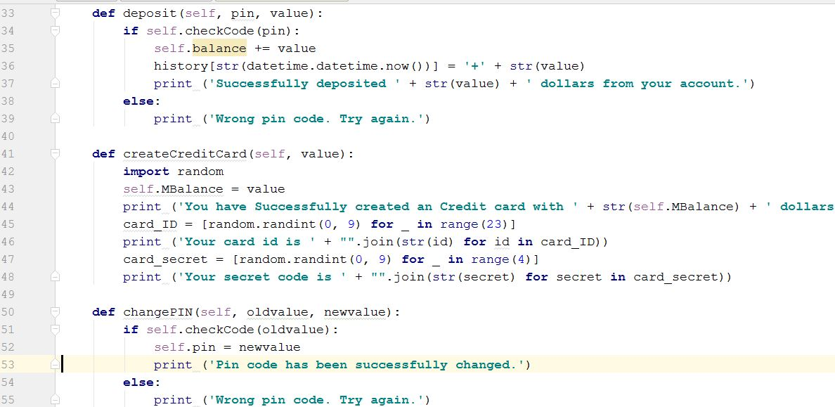
Other Functions of Account Class

Slide 42
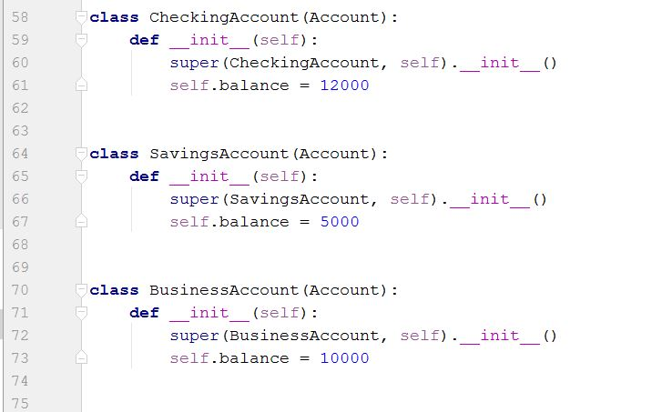
Inheritance: “Account” is passed in class declaration

Slide 43
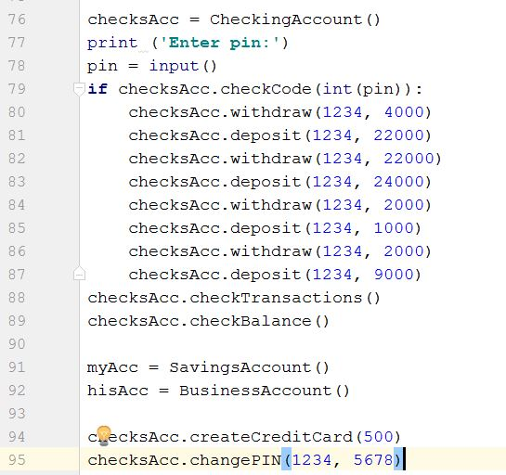
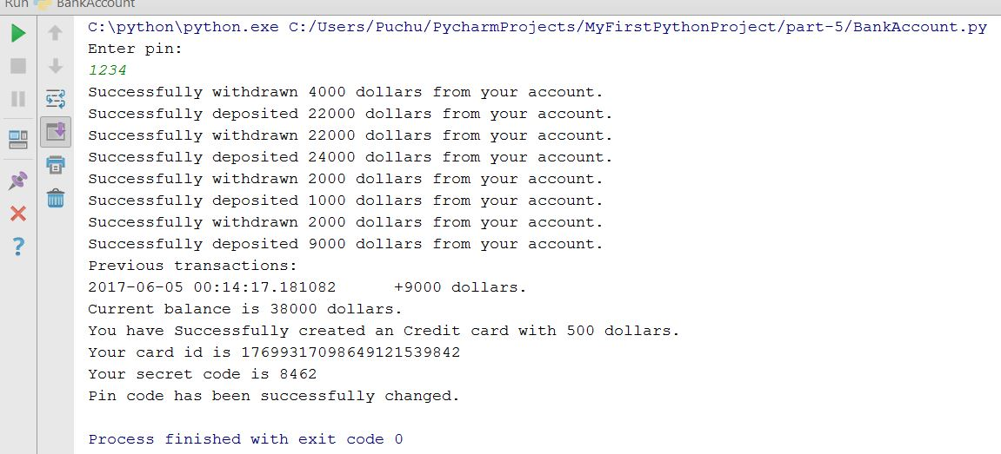
Output
Instance Creation

Slide 44
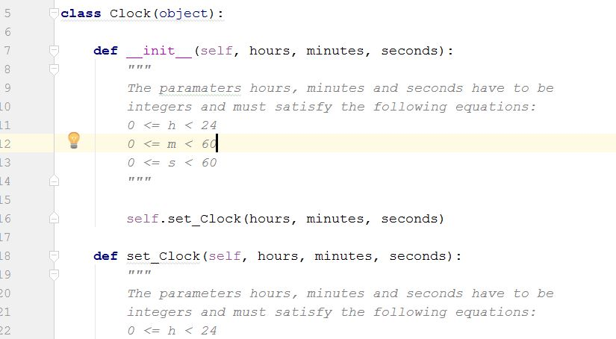
Use Case 2 - Multiple Inheritance
Clock Class

Slide 45
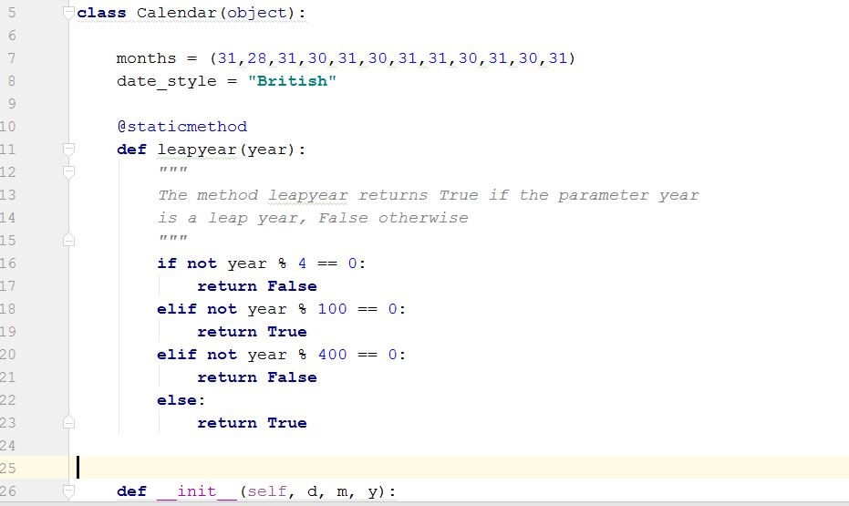
Calendar Class

Slide 46
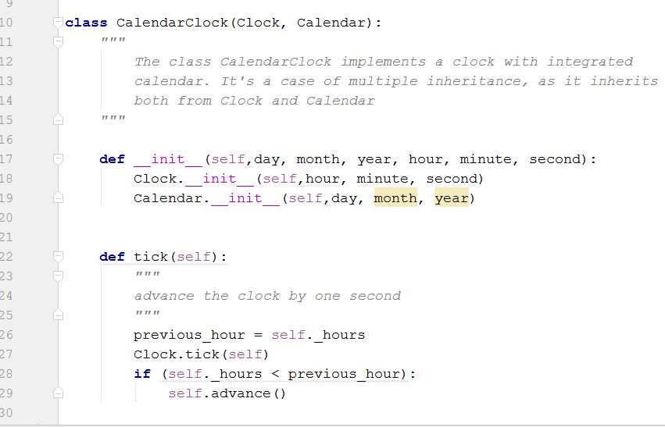
Calendar Class
Clock Class
We have created one class CalenderCLock to inherit both Clock and Calendar class features
Notice the super class constructor calling

Slide 47
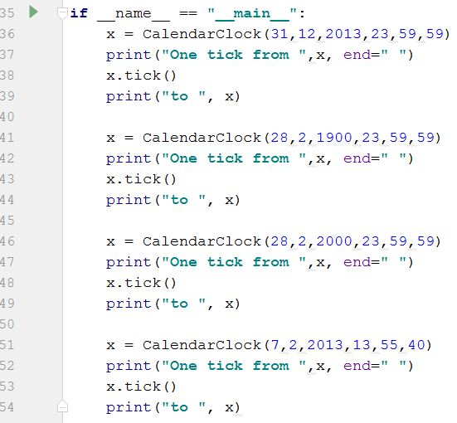
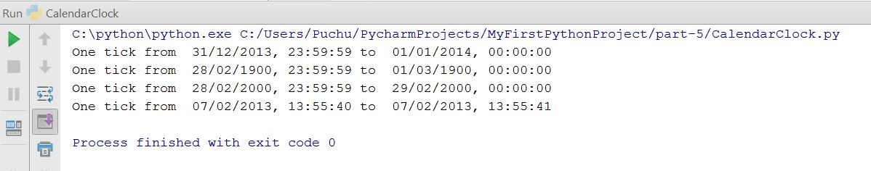
Output

Slide 48
Welcome to Machine Learning

Slide 49
Scientific Python?
Extra features required:
fast, multidimensional arrays
libraries of reliable, tested scientiﬁc functions
plotting tools
NumPy is at the core of nearly every scientific Python application or module since it provides a fast N-d array datatype that can be manipulated in a vectorized form.
49

Slide 50
Scientific Python Packages
numpy - mainly useful for its N-dimensional array objects
pandas - Python data analysis library, including structures such as dataframes
matplotlib - 2D plotting library producing publication quality figures
scikit-learn - the machine learning algorithms used for data analysis and data mining tasks

Slide 51
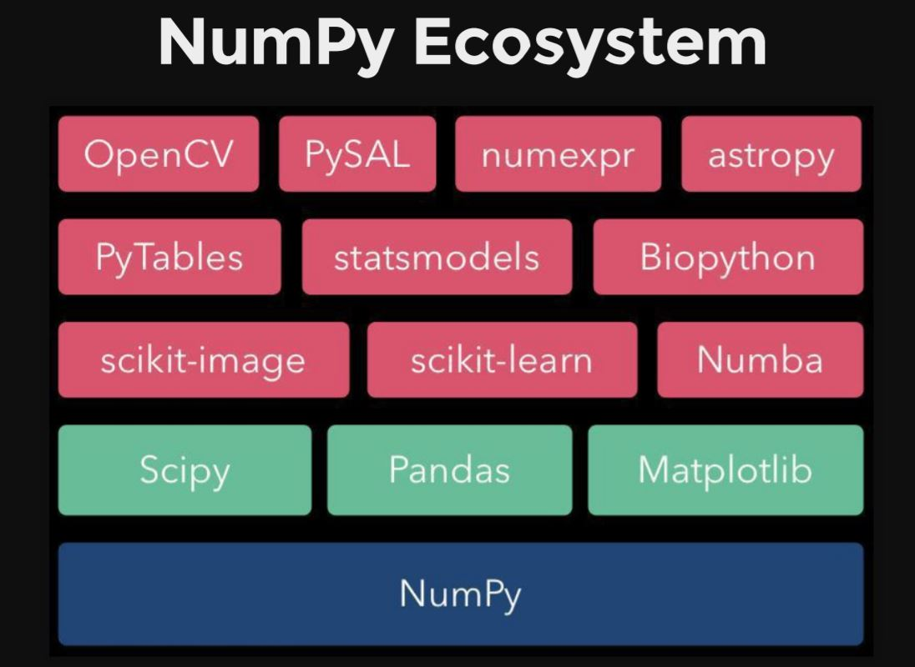
Numpy N-dimensional Array manipulations
Fundamental package for scientific computing with Python
N-dimensional array object
Linear algebra, Fourier transform, random number capabilities
Building block for other packages (e.g. Scipy)
Open source

Slide 52
Arrays – Numerical Python (Numpy)
Lists ok for storing small amounts of one-dimensional data
>>> a = [1,3,5,7,9]
>>> print(a[2:4])
[5, 7]
>>> b = [[1, 3, 5, 7, 9], [2, 4, 6, 8, 10]]
>>> print(b[0])
[1, 3, 5, 7, 9]
>>> print(b[1][2:4])
[6, 8]
>>> a = [1,3,5,7,9]
>>> b = [3,5,6,7,9]
>>> c = a + b
>>> print c
[1, 3, 5, 7, 9, 3, 5, 6, 7, 9]
But, can’t use directly with arithmetical operators (+, -, *, /, …)
Need efﬁcient arrays with arithmetic and better multidimensional tools
Numpy
Similar to lists, but much more capable, except ﬁxed size
>>> import numpy

Slide 53
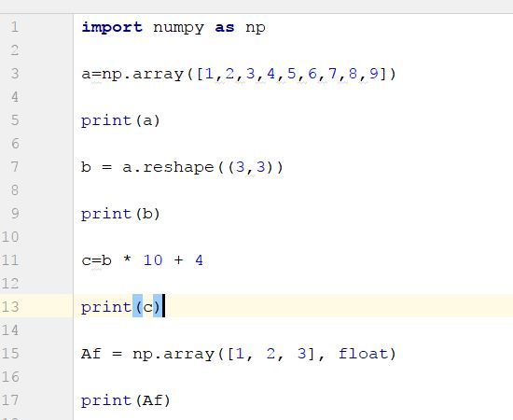
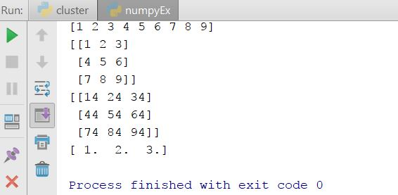
Import numpy – Basic Operations

Slide 54
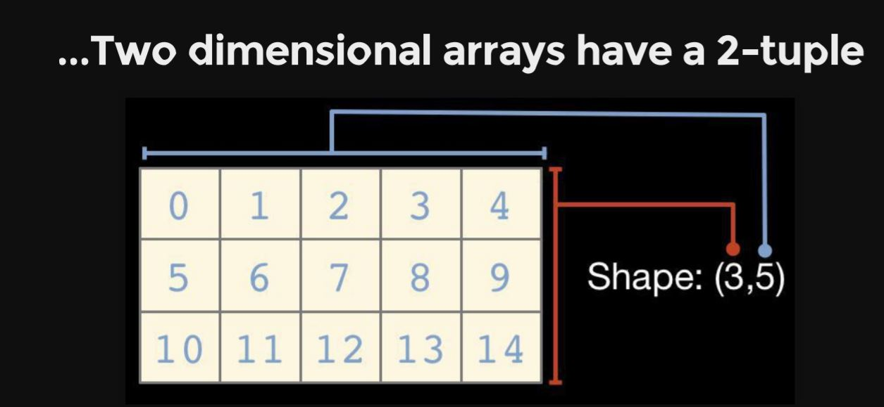
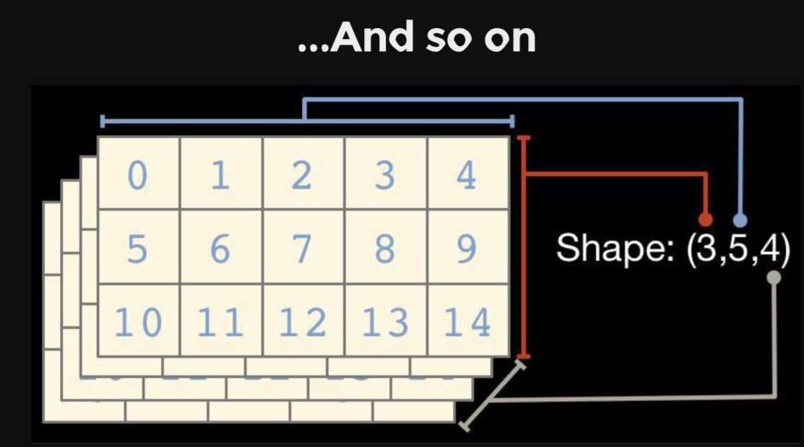
Reshape functions

Slide 55
numpy.ndarray.dtype
Numpy array comprises elements of single data type
Important attributes
dtype.byteorder — big or little endian
dtype.itemsize — element size of this dtype
dtype.name — a name for this dtype object
dtype.type — type object used to create scalars
There are many others...

Slide 56
others
Input | Description | Output
np.arange(10) | Range of values | [0 1 2 3 4 5 6 7 8 9]
np.linspace(0,1,5) | By Specifying the number of elements | [ 0. 0.25 0.5 0.75 1. ]
np.zeros((2,2)) | Zero-initialized | [[ 0. 0.] [ 0. 0.]]
np.ones((2,2)) | One-initialized | [ 1. 1.] [ 1. 1.]]
np.empty((2,2)) | uninitialized | [[ 0. 0.] [ 0. 0.]]
np.eye(3) | Constant diagonal value | [ 1. 0. 0.] [ 0. 1. 0.] [ 0. 0. 1.]]
np.diag([1,2,3,4]) | Multiple diagonal values | [[1 0 0 0] [0 2 0 0] [0 0 3 0] [0 0 0 4]]

Slide 57
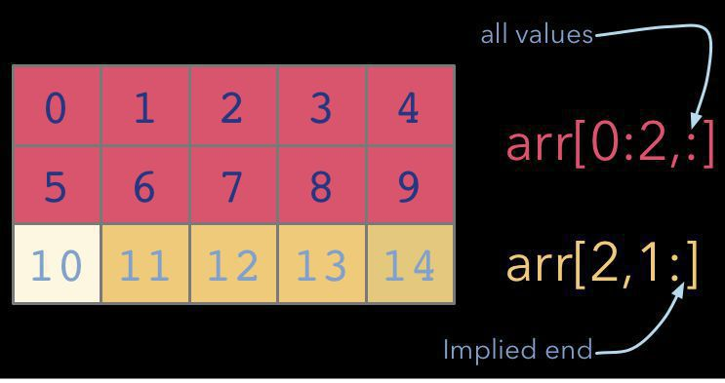
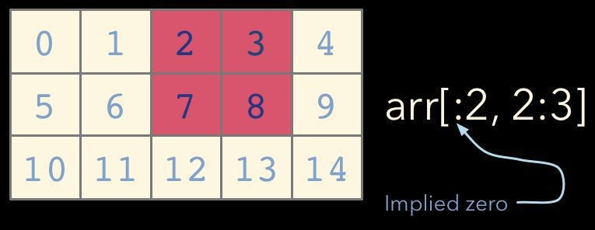
Indexing and Slicing as usual lists

Slide 58
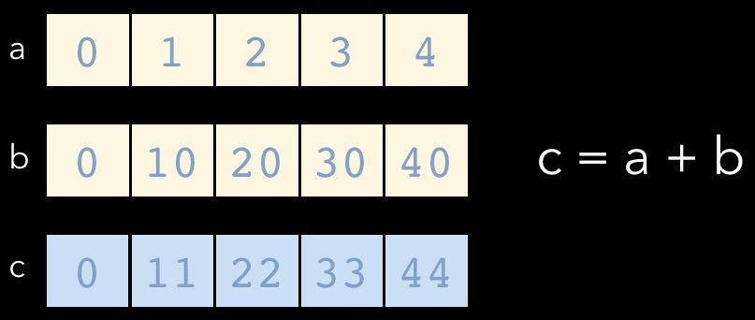
Universal Functions (ufuncs)
NumPy ufuncs are functions that operate element-wise on one or more arrays
ufuncs dispatch to optimized C inner-loops based on array dtype

Slide 59
NumPy has many built-in ufuncs
comparison: <, <=, ==, !=,
>=, >
arithmetic: +, -, *, /, reciprocal, square
exponential: exp, expm1, exp2, log, log10, power, sqrt
log1p,
log2,
trigonometric: sin, cos, tan, acsin, arccos,
atctan
hyperbolic: sinh, cosh, tanh, acsinh, arccosh,
atctanh
bitwise operations: &, |, ~, ^, left_shift, right_shift
logical operations: and, logical_xor, not, or
predicates: isfinite, isinf, isnan, signbit
other: abs, ceil, floor, mod, modf, round, trunc
sinc,
sign,

Slide 60
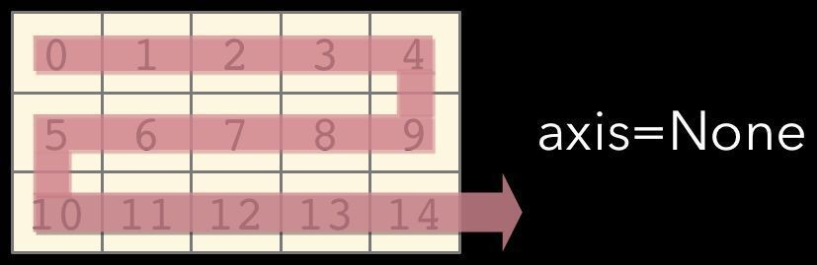
Axis
Array method reductions take an optional axis parameter that specifies over which axes to reduce
axis=None reduces into a single scalar
In [7]: a.sum ()
Out[7]: 105
axis=None is the default

Slide 61
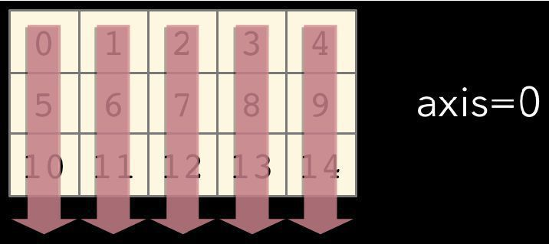
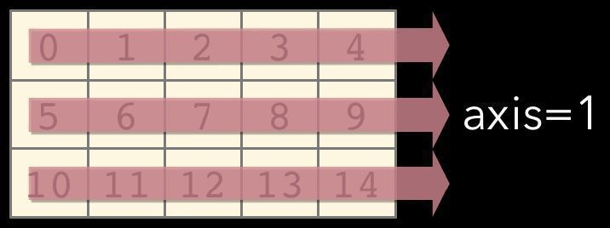
axis=0 reduces into the zeroth dimension
In [8]: a.sum(axis=0 )
Out[8]: array([15, 18, 21, 24,
27])
axis=1 reduces into the first dimension
In [9]: a.sum(axis= 1) Out[9]: array([10, 35, 60])

Slide 62
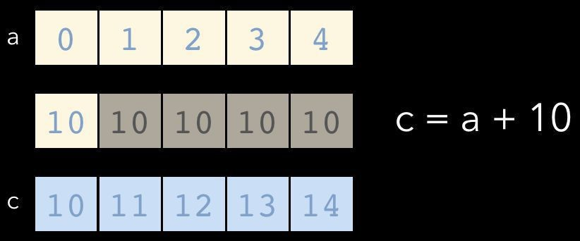
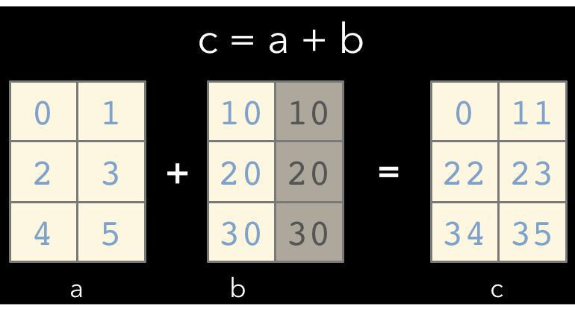
Broadcasting
A key feature of NumPy is broadcasting, where arrays with different, but compatible shapes can be used as arguments to ufuncs
Here an array of shape (3,
In this case an array scalar is broadcast to an array with shape (5, )
1) is broadcast to an array with shape
(3, 2)

Slide 63


Broadcasting Rules
In order for an operation to broadcast, the size of all the trailing dimensions for both arrays must either:
be equal
OR be one
A | (1d | array): |  |  |  |  |  |  | 3
B | (2d | array): |  |  |  |  | 2 | x | 3
Result | (2d | array): |  |  |  |  | 2 | x | 3
A | (2d | array): |  |  |  |  | 6 | x | 1
B | (3d | array): |  |  | 1 | x | 6 | x | 4
Result | (3d | array): |  |  | 1 | x | 6 | x | 4
A | (4d | array): | 3 | x | 1 | x | 6 | x | 1
B | (3d | array): |  |  | 2 | x | 1 | x | 4
Result | (4d | array): | 3 | x | 2 | x | 6 | x | 4

Slide 64
Array Methods
Predicates
a.any(),
Reductions
a.all()
a.mean(),
a.argmin(),
a.argmax(),
a.trace(),
a.cumsum(),
Manipulation
a.cumprod()
a.argsort(),
a.transpose(),
a.reshape(...),
a.ravel(),
a.fill(...),
a.clip(...)
Complex Numbers
a.real, a.imag,
a.conj()

Slide 65
NumPy Functions
Data I/O
fromfile, genfromtxt,
Mesh Creation
load,
loadtxt,
save,
savetxt
mgrid, meshgrid, ogrid
Manipulation
einsum, hstack, take, vstack
Array Subclasses
numpy.ma — Masked arrays
numpy.matrix — Matrix operators
numpy.memmap — Memory-mapped arrays
numpy.recarray — Record arrays

Slide 66
Other Subpackages
numpy.fft — Fast Fourier transforms
numpy.polynomial — Efficient polynomials
numpy.linalg — Linear algebra
cholesky, det, eig, eigvals, inv, lstsq, norm, qr, svd
numpy.math — C standard library math functions
numpy.random — Random number generation beta, gamma, geometric, hypergeometric, normal, poisson, uniform, weibull

Slide 67
More
Input | Output | Desc
np.random.random((2,3)) | [[ 0.0028206 0.73486004 0.07416516] [ 0.69691992 0.65554942 0.67732808]] | Random
np.random.normal(loc=1.0, scale=2.0, size=(2,2)) | [[ 0.3378941 2.44143865] [-0.88674669 0.90112657]] | Random with loc and scale
np.savetxt("a_out.txt", a) |  | Save to file
np.loadtxt("a_out.txt") |  | Load from file

Slide 68
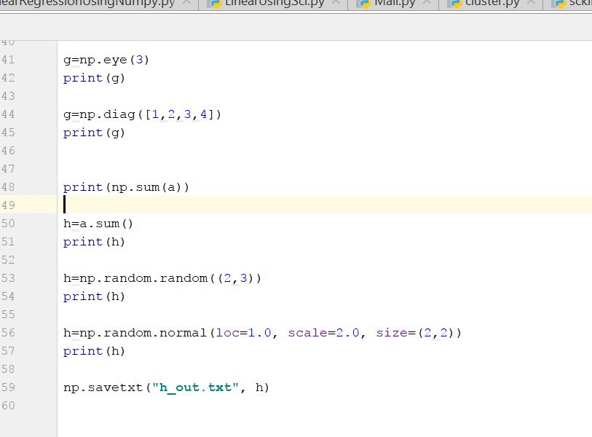
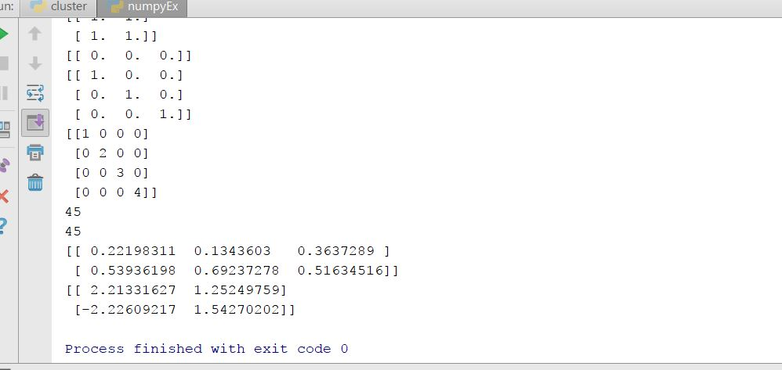
Numpy Usecase 3: numpyEx.py
Different functions of numpy and their output

Slide 69
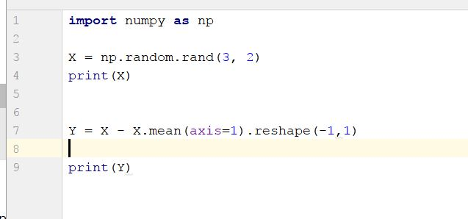
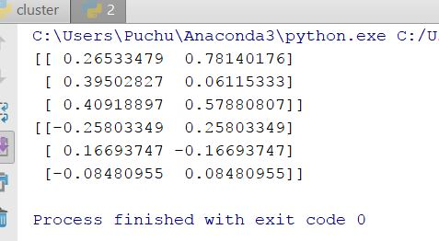
Usecase 4
Creating random matrix
Calculating mean for each row and then broadcasting to each element
output

Slide 70
In class Exercise
1. Create a class Student and then do the following
Create a data member to count number of students
Create a constructor to initialize name and other personal details
Create a function to calculate number of students
Create a function to display students name ,rollno and grades
Create a TransferStudent class and it should inherit the properties of Student class.
Create instances of TransferStudent and Student class and call their member functions.
2. Create a 10x10 array with random values and find the minimum and maximum values in the array.

Slide 71
Lab Assignment Submission Guidelines
Submit Assignment on Github with source code and create wiki page
https://goo.gl/forms/cxvY8Kg1pvNNzrpw1
Submit the code part to UMKC blackboard Turnitin
Remember similarity score should be less than 45%
Submit your screenshots as well.

Slide 72
References
https://www.csee.umbc.edu/courses/691p/notes/python/python3.ppt
https://www.cs.drexel.edu/~knowak/cs265_fall_2009/Python_Classes_nb.ppt
https://github.com/MiguelSOliveira/Python-Projects
https://webvalley.fbk.eu/static/media/uploads/presentations/introductiontonumpy2.pdf
http://jakevdp.github.io/blog/2013/08/07/conways-game-of-life/
http://www.python-course.eu/python3_multiple_inheritance.php
https://www.cs.drexel.edu/~knowak/cs265_fall_2009/Python_Classes_nb.ppt

